Slide 1
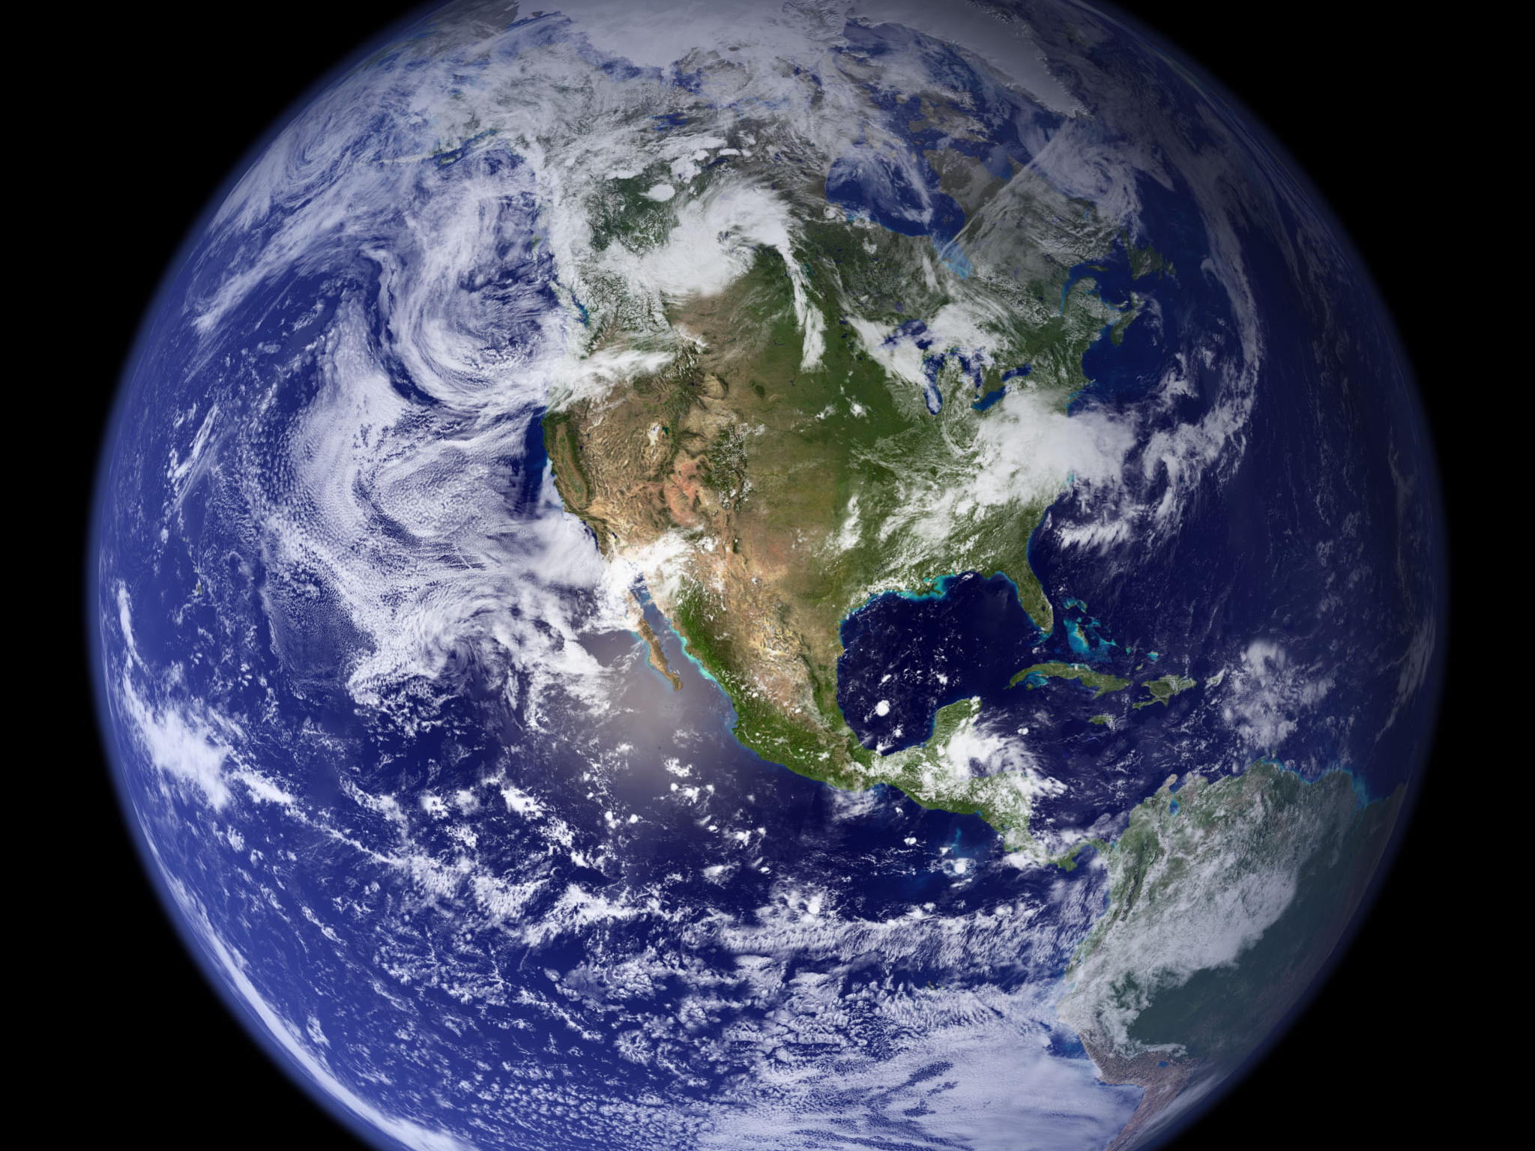
Image courtesy of NASA/GSFC

Slide 2
Global Climate Change
Eugene S. Takle
Professor
Department of Agronomy
Department of Geological and Atmospheric Science
Director, Climate Science Program
Iowa State University
Ames, IA 50011
Tanzanian Visitors
Iowa State University
14 May 2013

Slide 3
Outline
Brief review of future climate scenarios as projected by climate models
Projected changes in US climate
Changes of importance to agriculture
Recent trends in Iowa’s climate and producer adaptation
What about the future: droughts or floods?

Slide 4
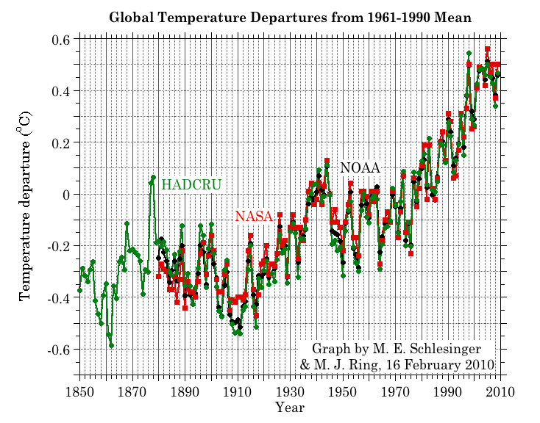
Three separate analyses of the temperature record – Trends are in close agreement
Don Wuebbles

Slide 5
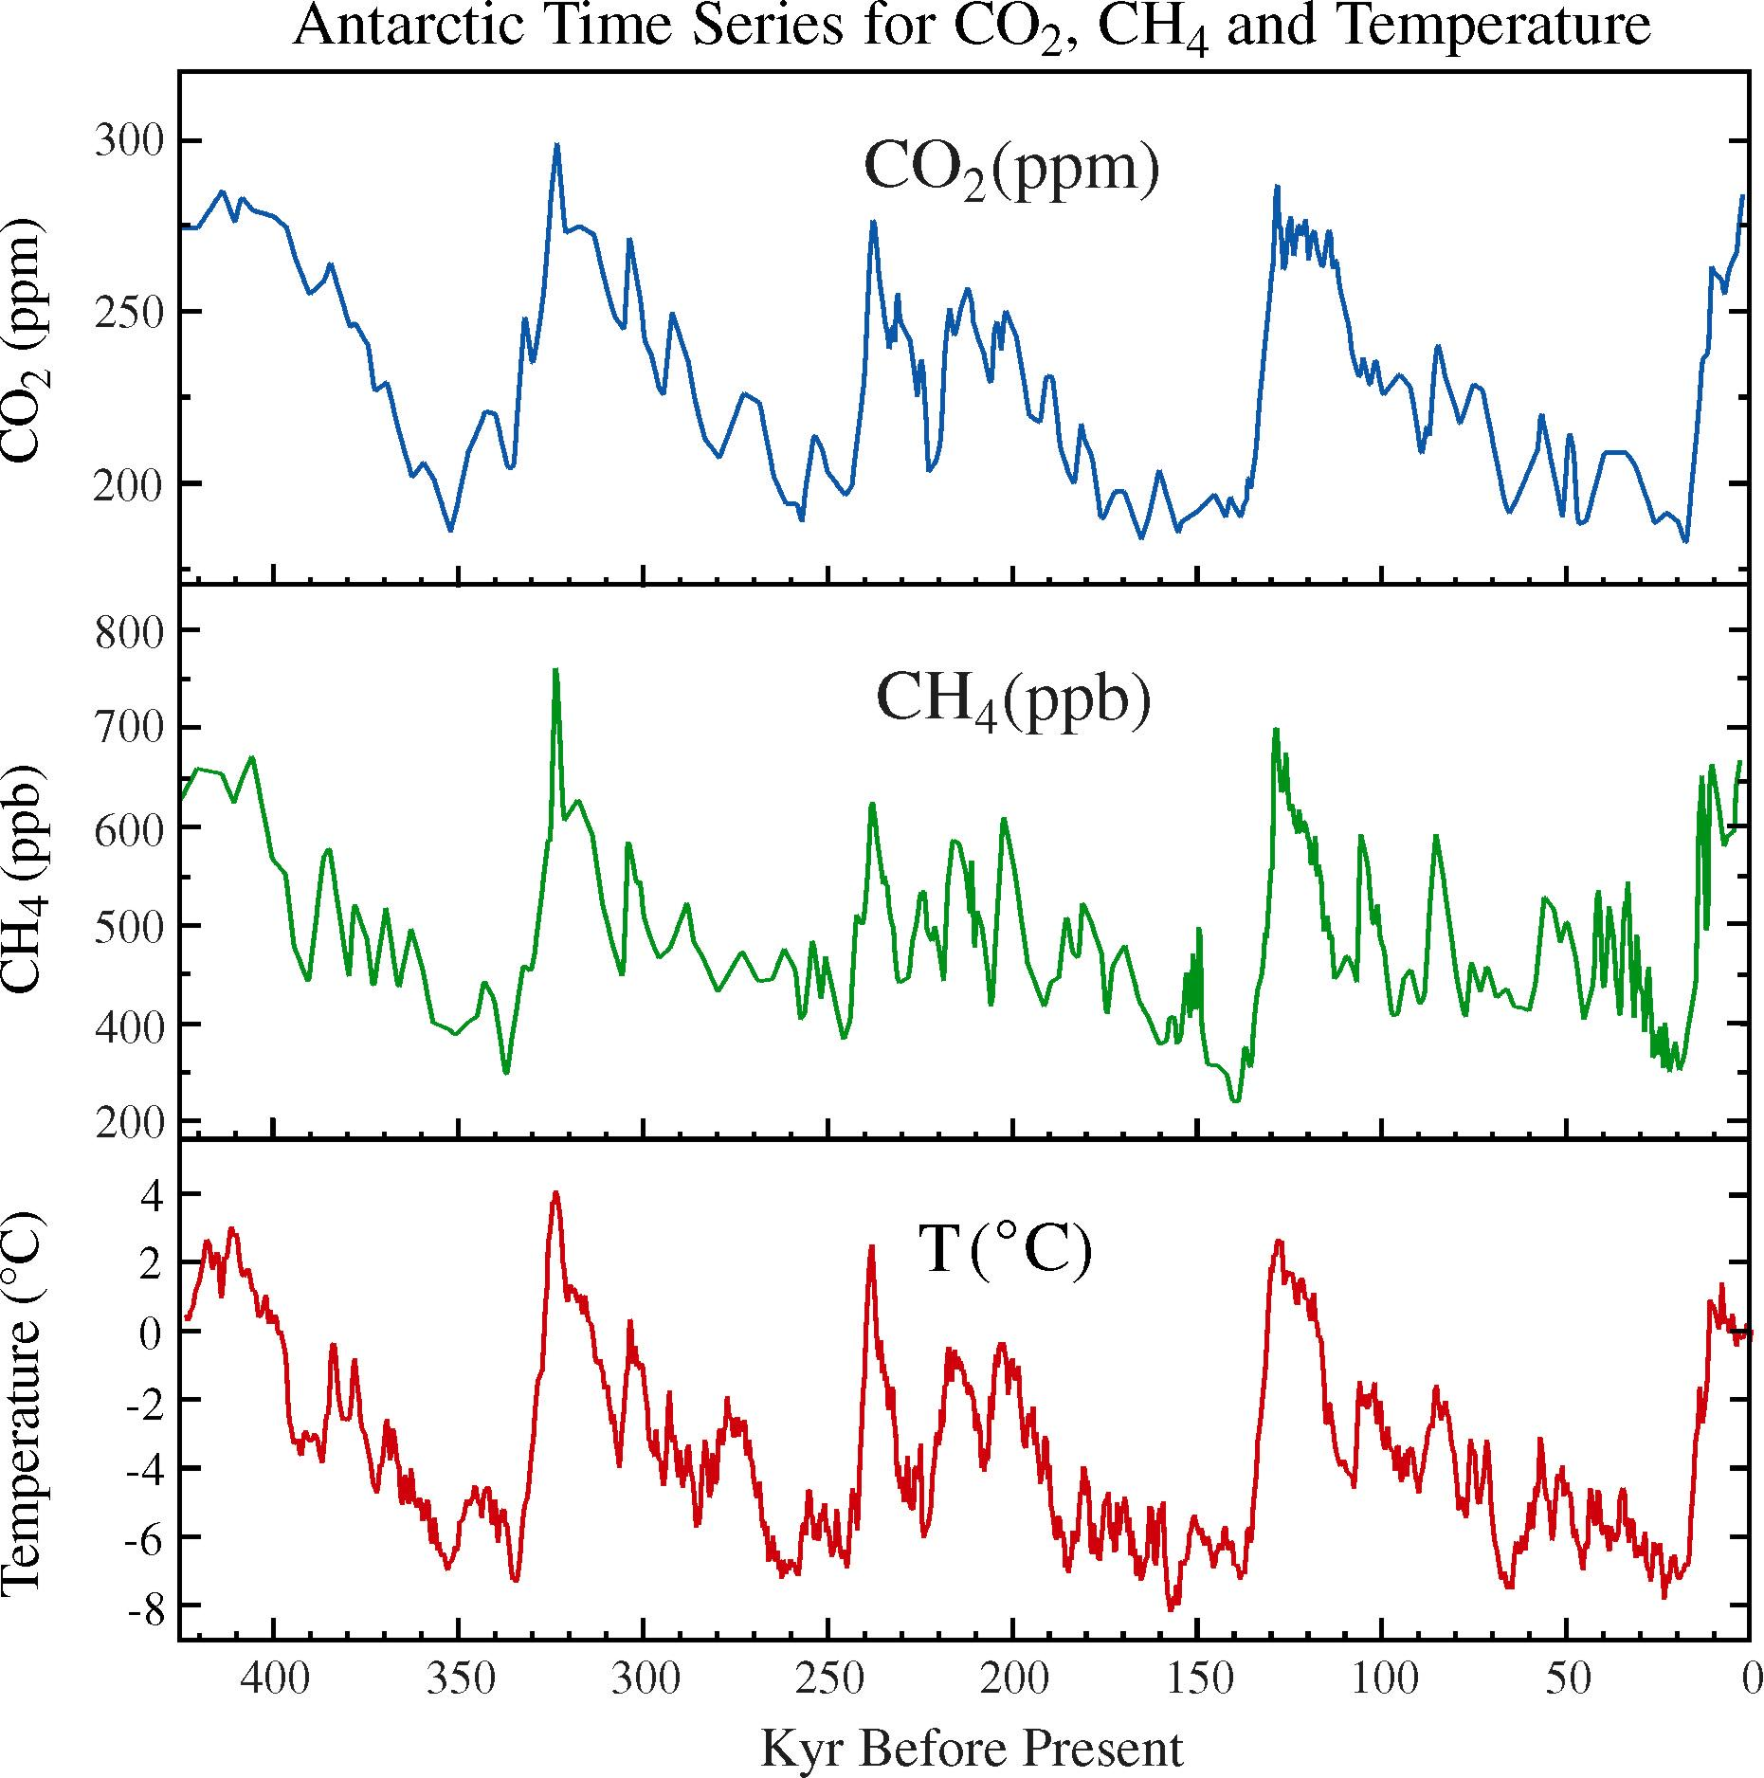
Methane:
1820 ppb ave in 2012
Carbon Dioxide:399.58 ppm last week

Slide 6
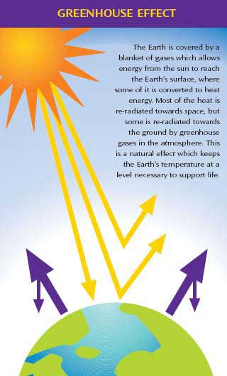
Why does the Earth warm?
1. Natural causes
THE GREENHOUSE EFFECT…
…is 100% natural.
  Heat is trapped in the atmosphere.
…sustains life on Earth.
  Keeps average temperatures at 12.8ºC (55ºF), instead of –29ºC (-20ºF).
Don Wuebbles

Slide 7
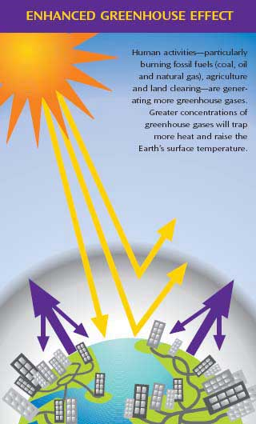
Why does the Earth warm?
2. Human causes
THE ENHANCED GREENHOUSE EFFECT
(or GLOBAL WARMING)
… is primarily human-induced: We’re increasing heat-trapping gases in the atmosphere.
… is like wrapping an extra blanket around the Earth.
Don Wuebbles

Slide 8
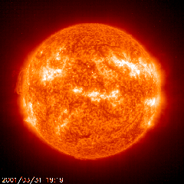
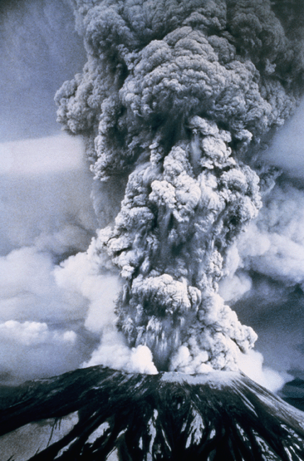
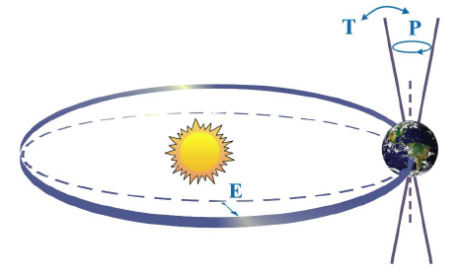

Natural factors affect climate
Variations in the energy
received from the sun
Variations in the Earth's orbit
(Milankovic effect)
Stratospheric
aerosols from
energetic
volcanic eruptions
Chaotic interactions in
the Earth's climate
(for example, El Nino, NAO)
Don Wuebbles

Slide 9
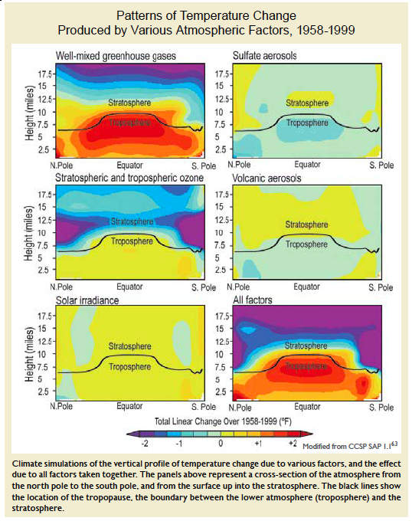
Warming of the Lower and Upper Atmosphere Produced by Natural and Human Causes
Karl, T. R., J. M. Melillo, and T. C. Peterson, (eds.), 2009: Global Climate Change Impacts in the United States. Cambridge University Press, 2009, 196pp.

Slide 10
Warming of the Lower and Upper Atmosphere Produced by Natural and Human Causes
Note that greenhouse gases have a unique temperature signature, with strong warming in the upper troposphere, cooling in the lower stratosphere and strong warming at the surface over the North Pole. No other warming factors have this signature.
Karl, T. R., J. M. Melillo, and T. C. Peterson, (eds.), 2009: Global Climate Change Impacts in the United States. Cambridge University Press, 2009, 196pp.

Slide 11
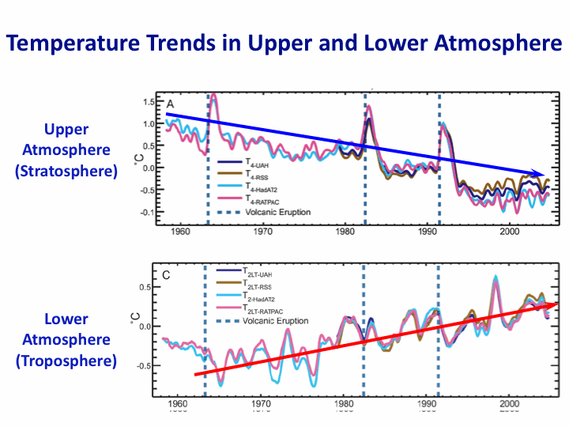
Warming of the Lower and Upper Atmosphere Produced by Natural and Human Causes
Note that greenhouse gases have a unique temperature signature, with strong warming in the upper troposphere, cooling in the lower stratosphere and strong warming at the surface over the North Pole. No other warming factors have this signature.
Karl, T. R., J. M. Melillo, and T. C. Peterson, (eds.), 2009: Global Climate Change Impacts in the United States. Cambridge University Press, 2009, 196pp.

Slide 12
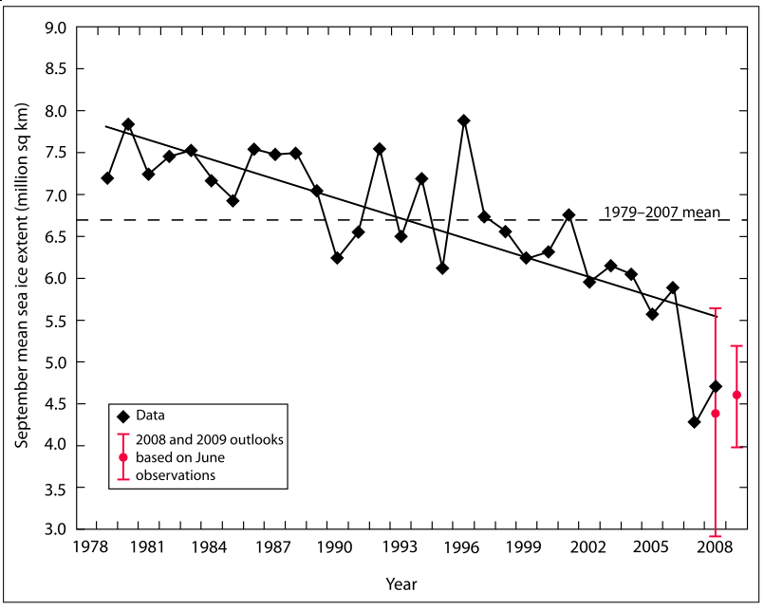
Warming of the Lower and Upper Atmosphere Produced by Natural and Human Causes
Note that greenhouse gases have a unique temperature signature, with strong warming in the upper troposphere, cooling in the lower stratosphere and strong warming at the surface over the North Pole. No other warming factors have this signature.

Slide 13
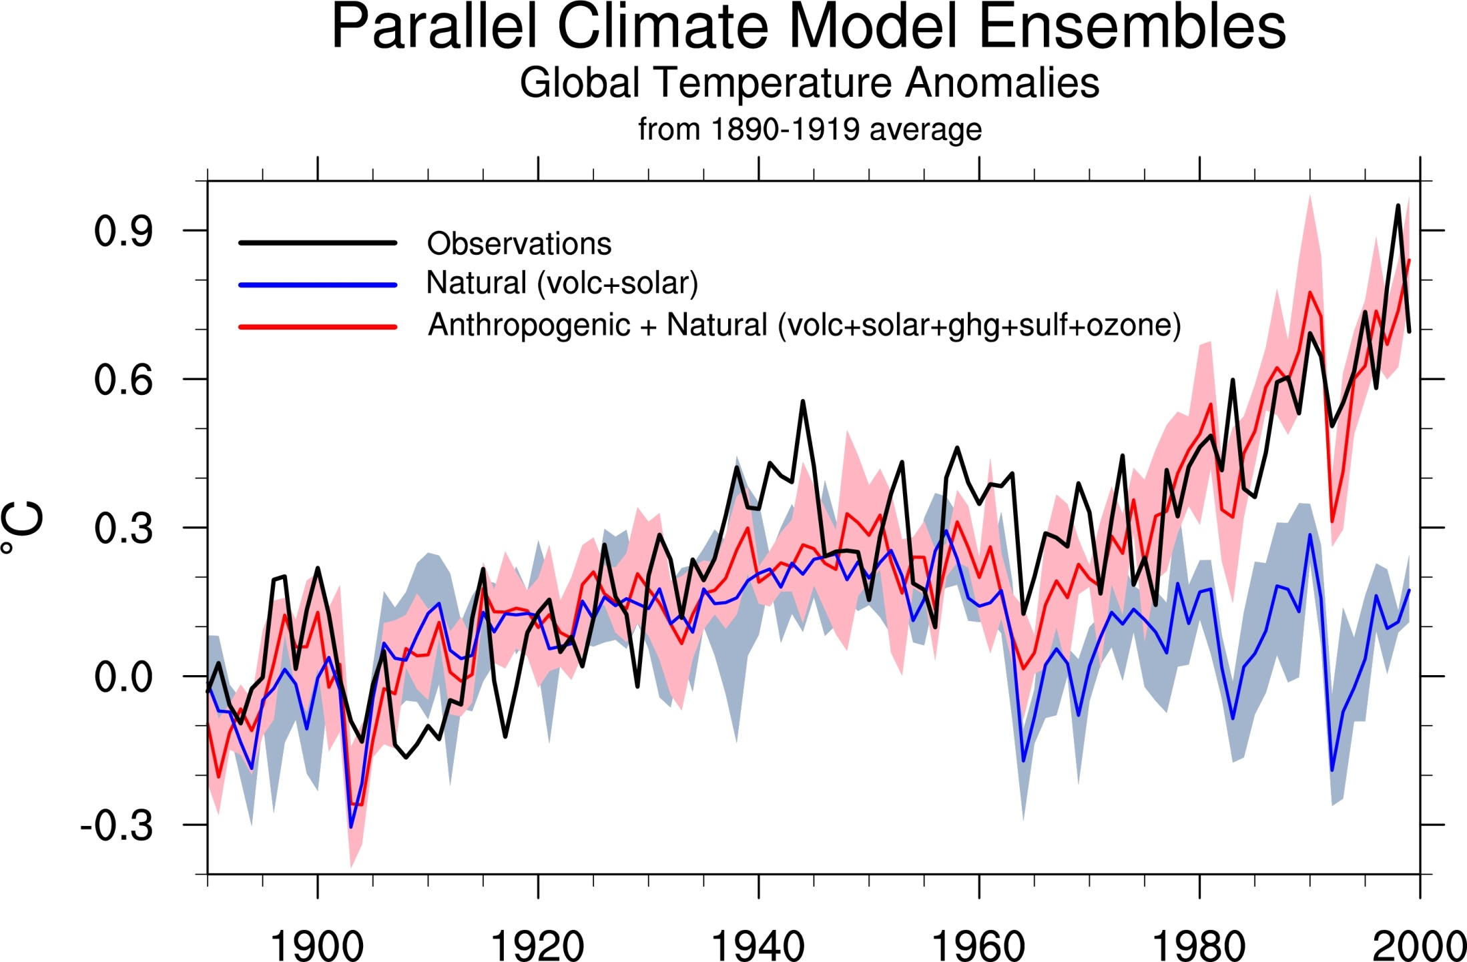
Climate models: Natural processes do not account for
observed 20th century warming after 1965

Slide 14
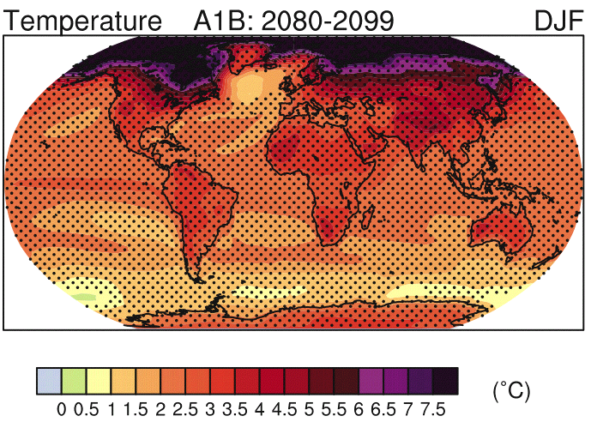
+2.5ºC
IPCC 2007

Slide 15
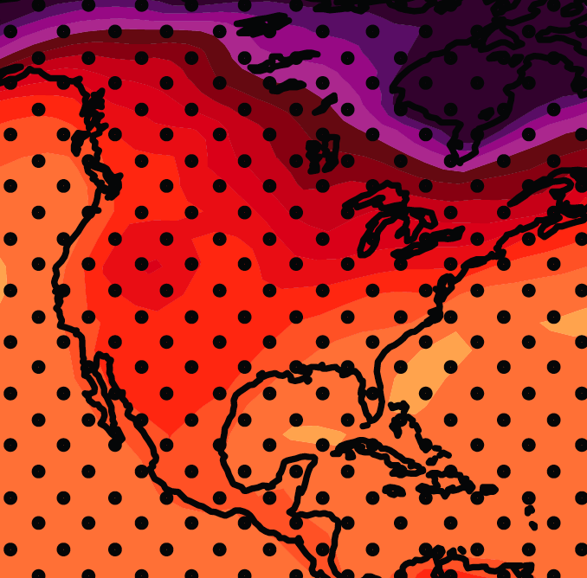
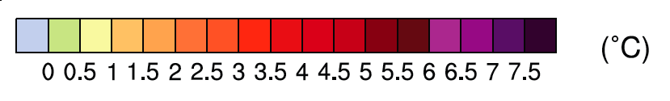
December-January-February Temperature Change
7.2ºF
6.3ºF
A1B Emission Scenario
2080-2099 minus1980-1999

Slide 16
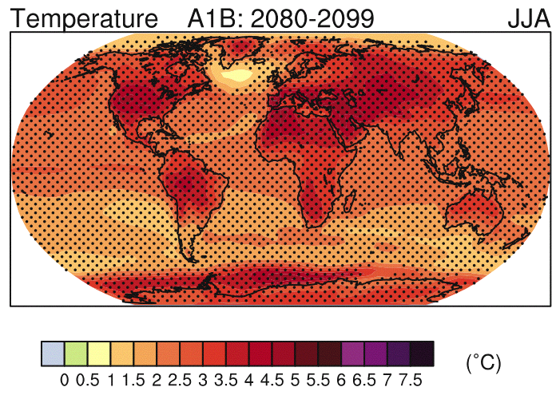
+2.5ºC
IPCC 2007

Slide 17
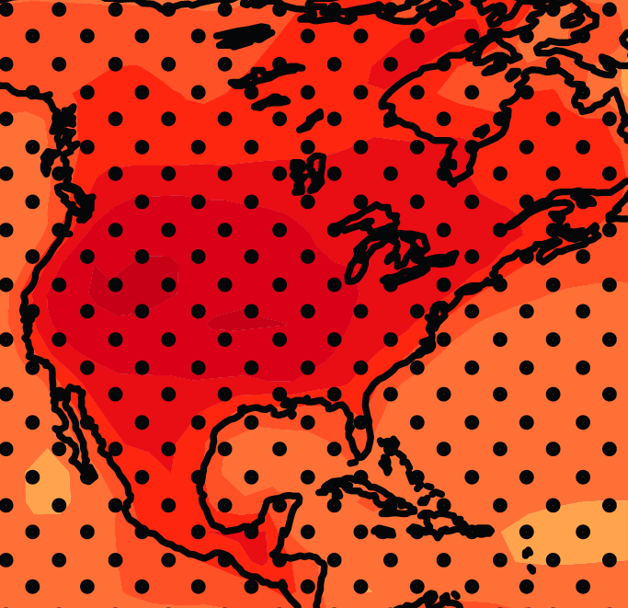
June-July-August Temperature Change
4.5ºF
5.4ºF
A1B Emission Scenario
2080-2099 minus1980-1999

Slide 18
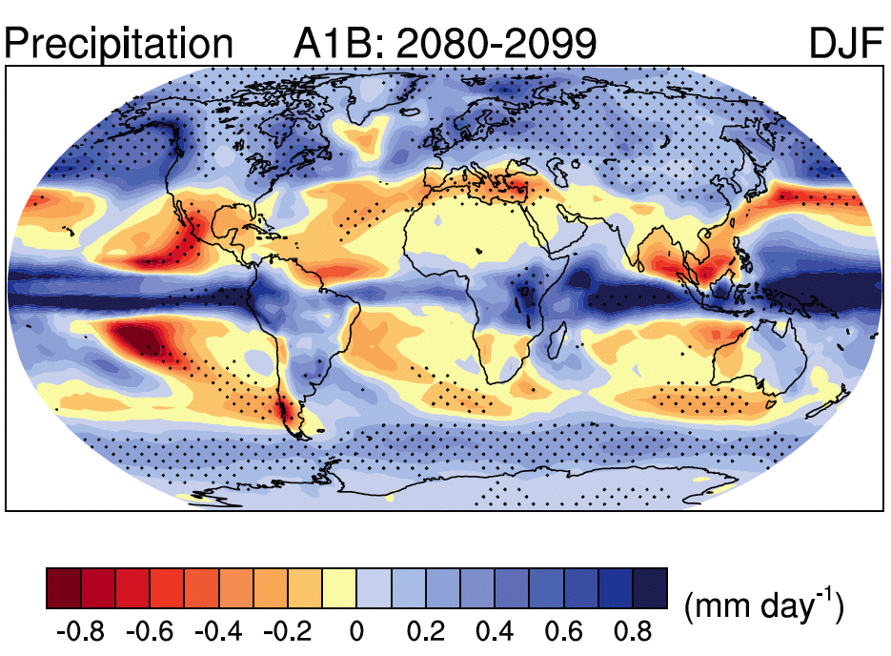
Source: IPCC 4th Assessment Report, 2007

Slide 19
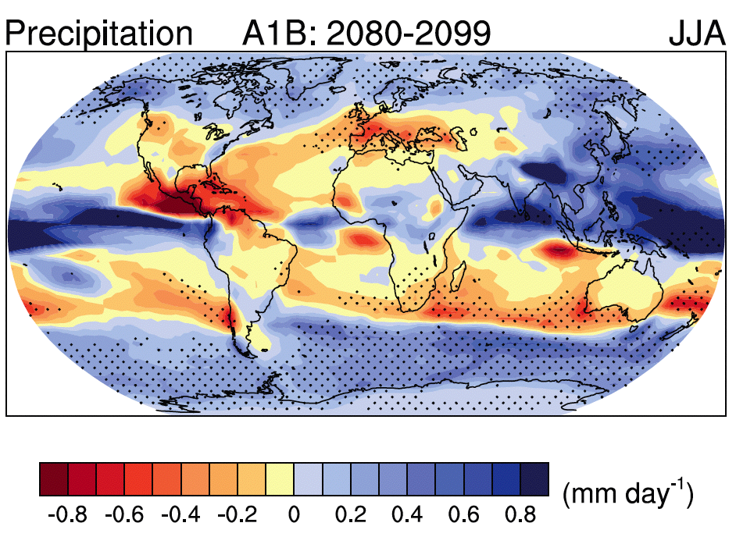
Source: IPCC 4th Assessment Report, 2007

Slide 20
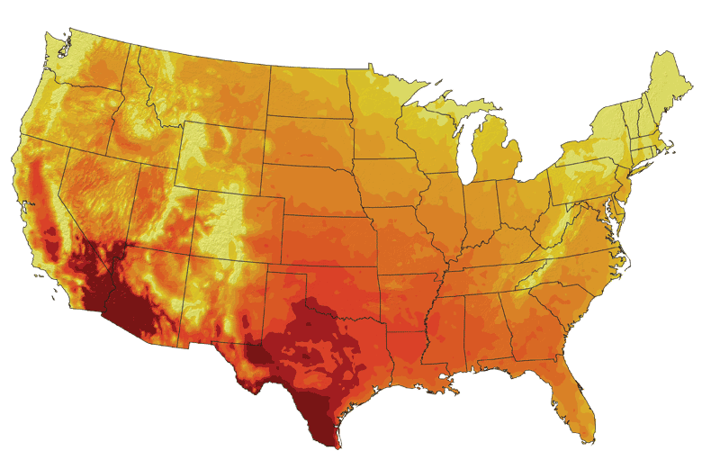
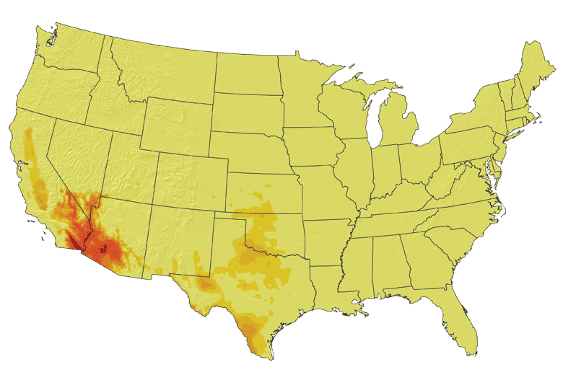
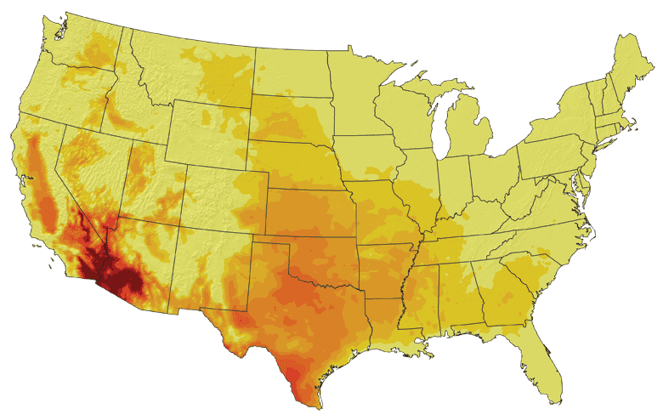
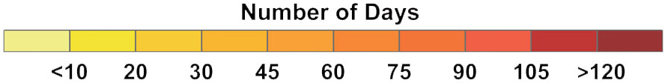
Increases in very high temperatures will have
wide-ranging effects
Higher Emissions Scenario, 2080-2099
38ºC
Number of Days Over 100ºF
Recent Past, 1961-1979
Average:
30-60 days
Lower Emissions Scenario, 2080-2099
Average:
10-20 days

Slide 21
Increases in very high temperatures will have
wide-ranging effects
Higher Emissions Scenario, 2080-2099
Number of Days Over 100ºF
Recent Past, 1961-1979
Average:
30-60 days
Current Des Moines average is < 1.4 days per year over 100ºF
Lower Emissions Scenario, 2080-2099
Average:
10-20 days
Don Wuebbles

Slide 22
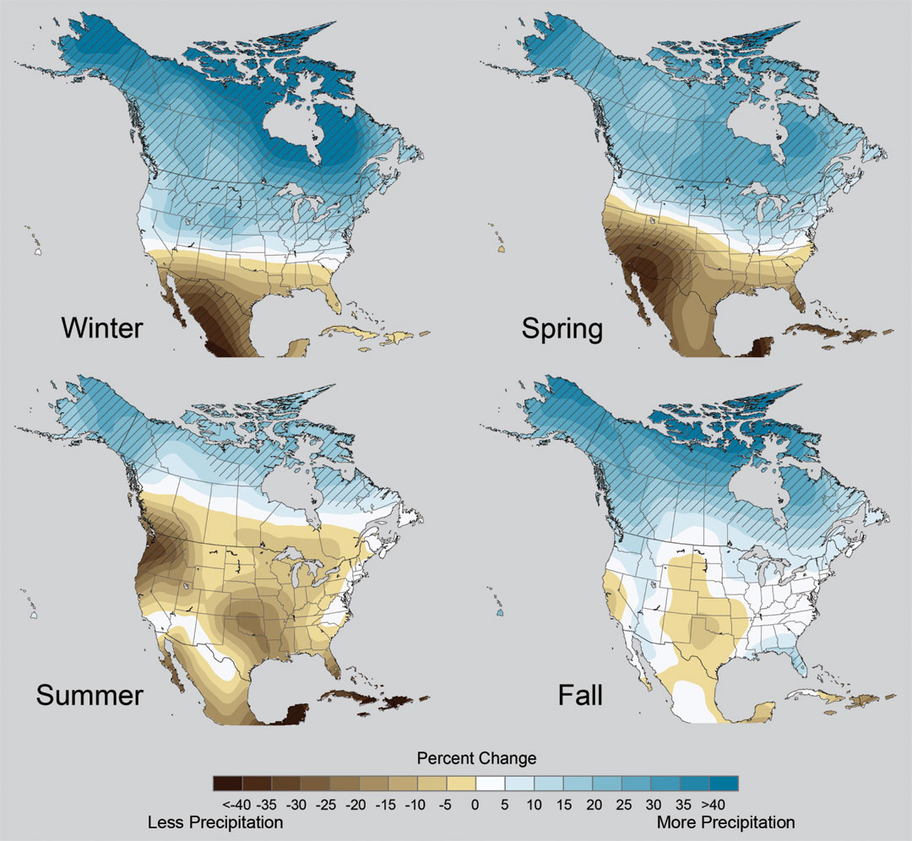
Projected Change in Precipitation: 2081-2099
Midwest: Increasing winter and spring precipitation, with drier summers
More frequent and intense periods of heavy rainfall
Unstippled regions indicate reduced confidence
CAUTION: High uncertainty
Relative to 1960-1990
NOTE: Scale Reversed

Slide 23
Percent Changes in Crop Yield with
Projected Changes in Annual Mean Temperature
(not water or nutrient limited)
California Central Valley
Lee, J., S. DeGryze, and J. Six. 2011. Effect of climate change on field crop production in the California’s Central Valley. Climatic Change. 109(Suppl):S335-S353

Slide 24
Projected Yield Changes for California Crops
Simulations using the DAYCENT model while ensuring water supplies and nutrients were maintained at adequate levels under low (B1) and medium-high (A2) emissions scenarios.
Lee, J., S. DeGryze, and J. Six. 2011. Effect of climate change on field crop production in the California’s Central Valley. Climatic Change. 109(Suppl):S335-S353

Slide 25
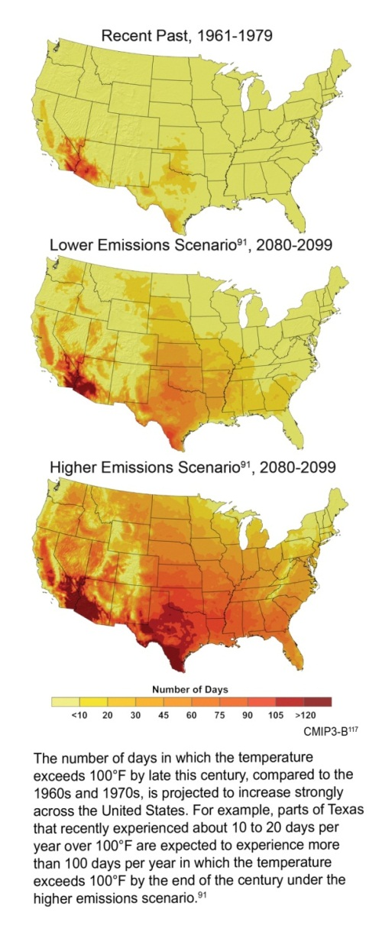
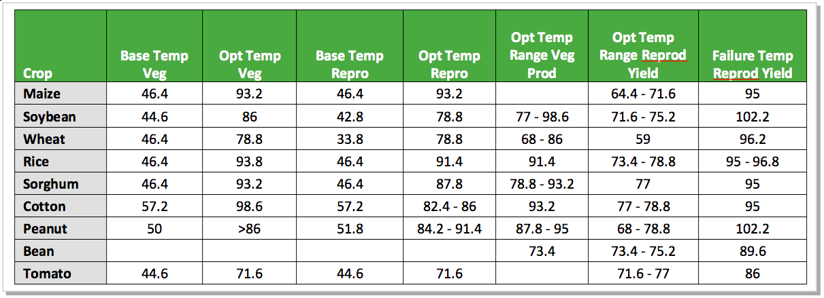
Crop Yield and Grain Quality are Compromised by Temperature Increase
Days/Yr with T>100ºF
Rising daily maximum temperatures increase the likelihood of extended periods with temperatures above the failure point for reproduction (grain production)
Rising nighttime temperatures (ºF) decrease the quality of grain (corn)

Slide 26
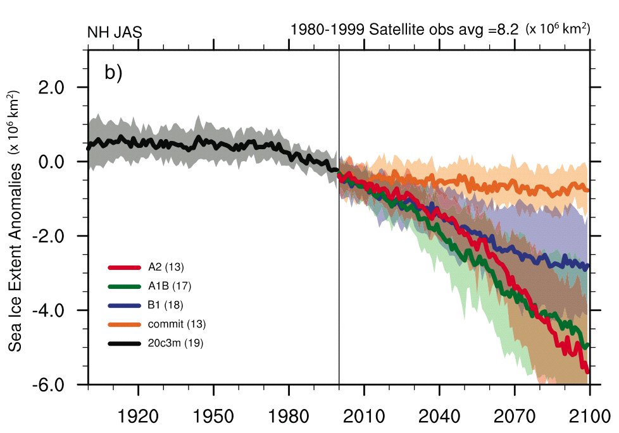
Arctic Sea-Ice Extent Observed and Projected by Global Climate Models
2005
Aug 2008
2007
Meehl, G.A.,et al, 2007: Global Climate Projections. In: Climate Change 2007: The Physical Science Basis. Contribution of Working Group I to the Fourth Assessment Report of the Intergovernmental Panel on Climate Change [Solomon, S., D. Qin, M. Manning, Z. Chen, M. Marquis, K.B. Averyt, M. Tignor and H.L. Miller (eds.)]. Cambridge University Press, Cambridge, United Kingdom and New York, NY, USA. Chapter 10, p. 771

Slide 27
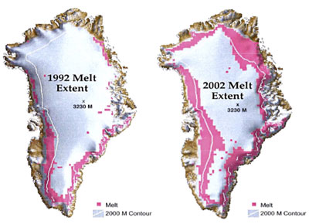

Slide 29
For More Information:
Climate Science Program
Iowa State University
http://climate.engineering.iastate.edu/
http://www.meteor.iastate.edu/faculty/takle/
gstakle@iastate.edu

